Slide 1
Final Presentation

Slide 2

Persistency of drugs
By : Cherif Sourour
Data Science Engineering Student
Esprit Tunisia

Slide 3
Agenda
Problem Statement
Business Understanding
Data Understanding
Approach
EDA
EDA Summary
Recommendations
Modelling

Slide 4
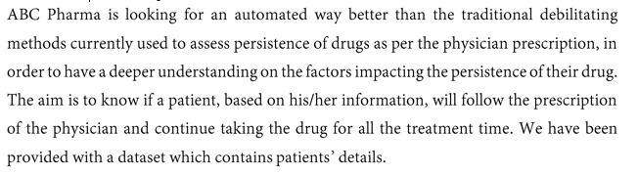
Business problem

Slide 5
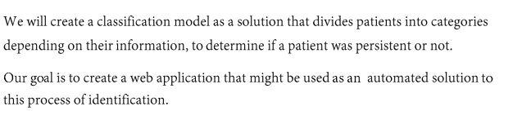
Business Understanding

Slide 6
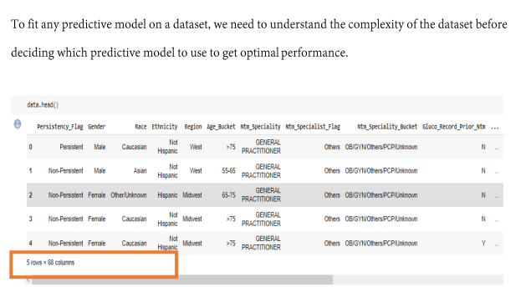
Data Understanding
Data Understanding and Cleaning Notebook

Slide 7
1 file was provided: Healthcare_dataset.xlsx
The file contained information of 3, 424 patients. For each patient it has demographic information, clinical records, others diseases as risk factor information and also about their physician's speciality.
The variables provided have been treated individually among the four members of the team.
The EDA has been carried out following the same arrangement, but taking into account the whole dataset, so that potential insights have been drawn from the analysis.
different model proposals have been developed.
Approach

Slide 8
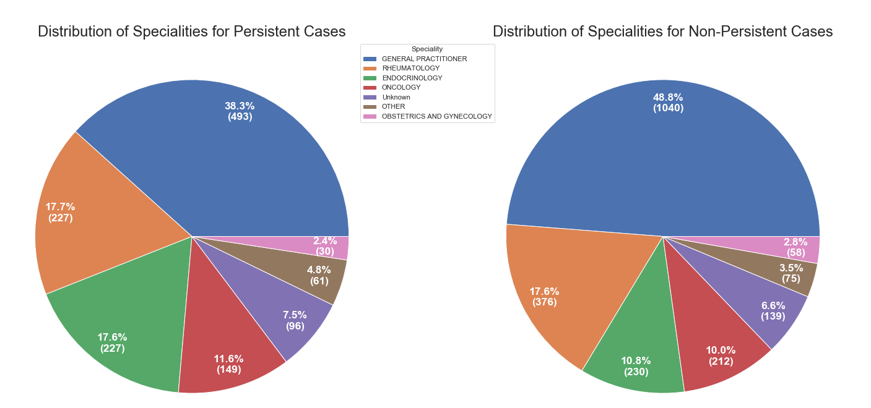
Clinical Factors
Does the speciality of the person who prescribed the drug have any effect on the persistent rate?
We see that both pie charts are pretty similar in distribution of frequency for each speciality. Thus, we can rule out the possibly that one of the factors that the drug is persistent or not is the speciality that prescribed the drug in the first place.

Slide 9
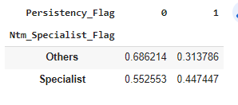
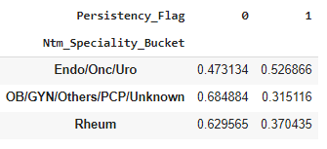
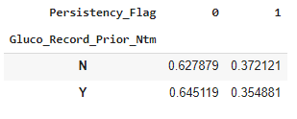
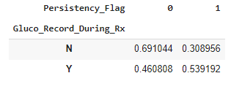
Clinical Factors
Does 'Ntm_Specialist_Flag' and 'Ntm_Speciality_Bucket'
Variables have useful information for the classification task?
It seems Rheum flag in Ntm_Speciality_Bucket have some useful information.
What about 'Gluco_Record_Prior_Ntm', 'Gluco_Record_During_Rx'?
Gluco_Record_During_Rx seems to be more useful than Gluco_Record_Prior_Ntm to predict the target

Slide 10
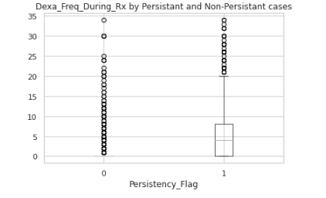
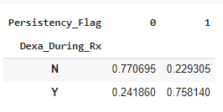
Clinical Factors
The distribution of Dexa_Freq_During_Rx numbers seems to be higher in the Persistent patients
Variables that are recorded during the treatment have more useful information for the classification than others. It can be checked with the percentages shown by Dexa_During_Rx variable.

Slide 11
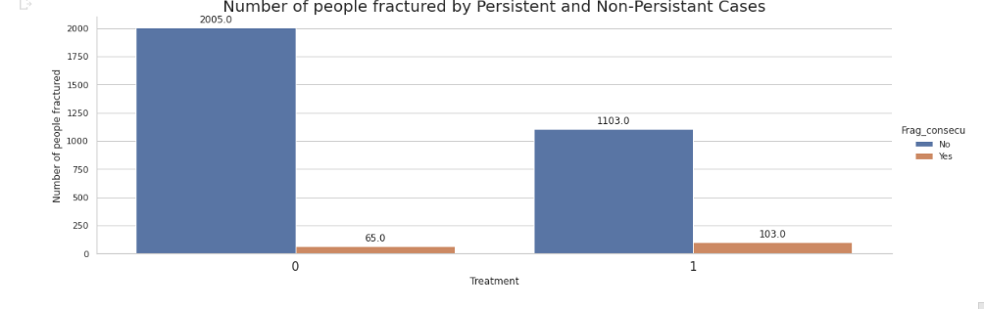
Fracture variable
Of the total number of patients, 8% of people were affected by the treatment, weakening their bones
The count of people affected by the treatment is small, and we can speculate that the treatment not affected considerably to the bones of the patients.

Slide 12
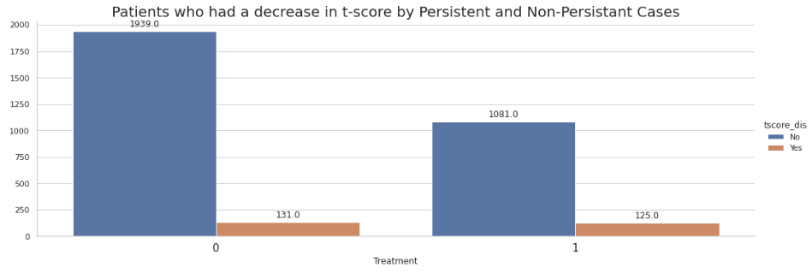
T-score variable
There is 10% of people with treatment who had a decrease in the t-score
Then there is 90% approximately of people who maintained or improved their t-score.
In conclusion, the treatment is improving the t-score of the patients.

Slide 13

Risk, comorbidity and concomitant factors
Most of the patients already hold comorbidity factors, while holding risk factors is less common.
Some highlights:
The main comorbidity factor is related to lipoproteins and metabolism (cholesterol).
The main risk factor is deficiency in vitamin D.
More than one third has been found to have taken narcotics.
99 % of our sample hold at least one risk, comorbidity and/or concomitant factor.

Slide 14
Risk, comorbidity and concomitant factors
There are some significant differences between genders:
Women seem to be more affected by vitamin D deficiencies.
More than twice as many women as men have passed as screening for malignant neoplasms.
Four times as many men as women suffer from Hypogonadism (untreated).

Slide 15
Risk, comorbidity and concomitant factors
As expected, patients older than 65 are affected by the mentioned factors in a higher proportion.
There are some risks and other factors that seem to be significantly higher in South and West regions. It might be interesting to find out about socioeconomic factors aside.
There seem to be some remarkable differences between Asian and other races. They are probably due to cultural factors and other behaviours, like medical reviews on a more regular basis (this is just a hypothesis to be found out).

Slide 16
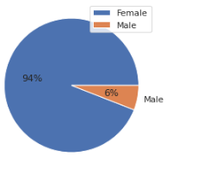
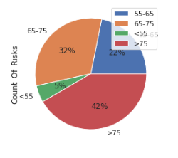
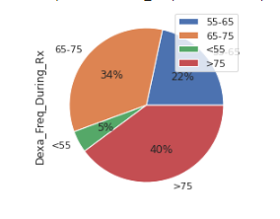
Dexa_Freq_During_Rx Count_Of_Risks Counts_Of_Risks
by Age_Bucket by Gender by Age-Bucket

Slide 17
EDA Summary
The file contained information of 3, 424 patients. For each patient it has demographic information, clinical records, others diseases as risk factor information and also about their physician's speciality.
There are some significant differences between genders (vitamin D deficiencies, screening for malignant neoplasms, Hypogonadism).
Most of the patients already hold comorbidity factors, while holding risk factors is less common.
Patients older than 65 are affected by the mentioned factors in a higher proportion.
There seem to be some remarkable differences between Asian and other races.
Variables that are recorded during the treatment like Dexa_Freq_During_Rx, Dexa_During_Rx and Gluco_Record_During_Rx have more useful information for the classification than others.

Slide 18
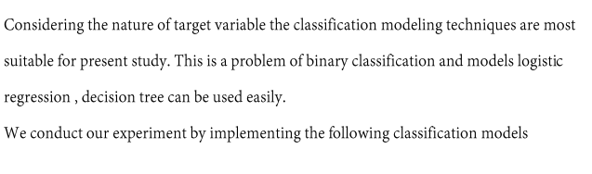
Modelling

Slide 19
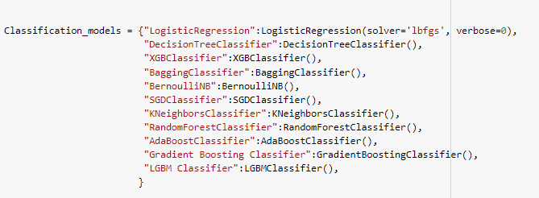
Models

Slide 20
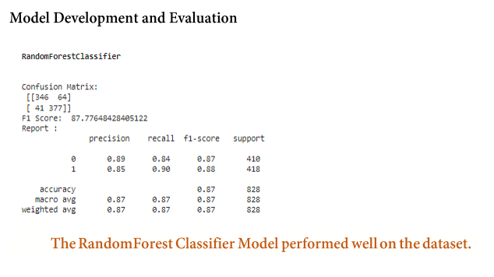

Slide 21
Thank you

